Slide 1
KEPLER ARCHITECTURE

Slide 2
OVERVIEW
It was initially planned to built for Tesla.
01
Intensive parallel computing in nature, efficient, consumes less power and generates less heat output.
02
Performs double precision calculation at the rate of 1/3 of single precision compute performance.
03
Dynamic Parallelism, Grid Management, Hyper-Q, Nvidia GPUDirect™ are some of the features that it provide.
04

Slide 3
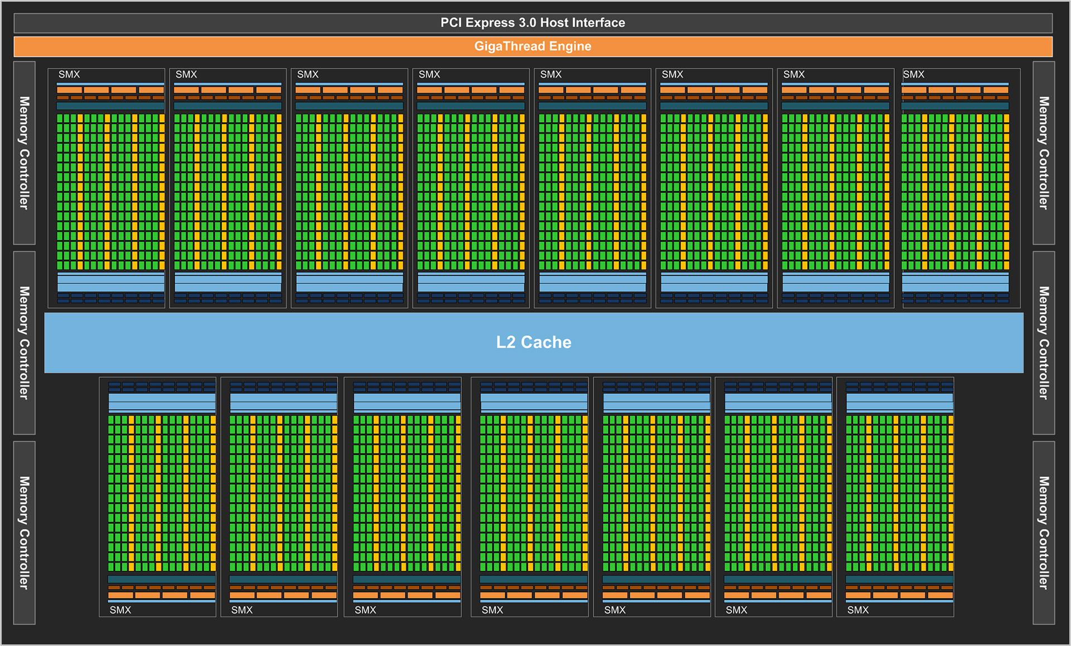
ARCHITECTURE
GK110 and GK210 includes
15 SMX units
Six 64-bit memory controllers.

Slide 4
KEY FEATURES
New SMX processor architecture.
Each SMX contains 192 single precision cuda cores, for better performance.
1
Enhanced memory subsystem, offering
2
Additional caching capability.
More bandwidth at each hierarchy level.
Faster DRAM I/O.
Hardware support throughout the design for new programming model capabilities.
3
GK210 expands on-chip resources, doubling the available register file and memory capacities per SMX.
4

Slide 5
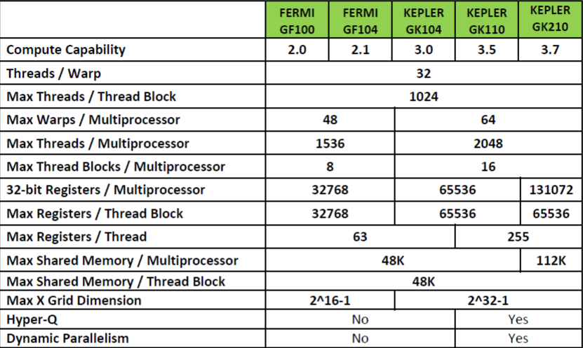
COMPUTE CAPABILITY

Slide 6
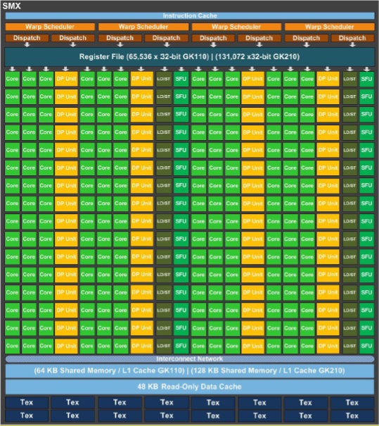
STREAMING MULTIPROCESSOR(SMX)
SMX features 192 single precision CUDA cores, each has fully functioned floating point and arithmetic logic units.
Retains SFU of fermi which is used for approximate transcendental(algebraic) operations.
Uses GPU clocks rather than 2x shader clock, for increasing the performance.
Design goals was to significantly increase GPU’s delivered double precision performance.

Slide 7
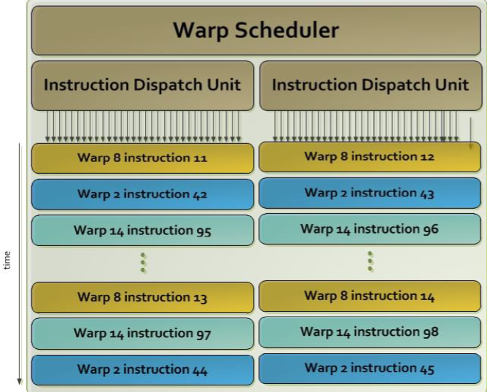
QUAD WARP SCHEDULER
The SMX schedules threads in groups of 32 parallel threads called warps.
Each SMX features,4 warp schedulers and 8 instruction dispatch units.
Kepler’s quad warp scheduler selects four warps, and two independent instructions per warp, dispatched at each cycle.
Time

Slide 8
OTHER KEY-POINTS
New ISA Encoding
Registers that can be accessed by a thread has been quadrupled in GK110,each thread can access to up to 255 registers
01
Shuffle Instruction
Shuffle instruction allows threads within a warp to share data.
Previously, sharing data between threads within a warp required separate store and load operations to pass the data through shared memory.
02
Atomic Operations
Read, modify, and write operations (add, min, max, and compare-and-swap) are performed without interruption by other threads.
03

Slide 9
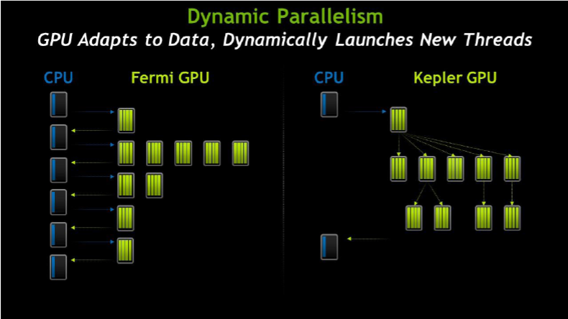
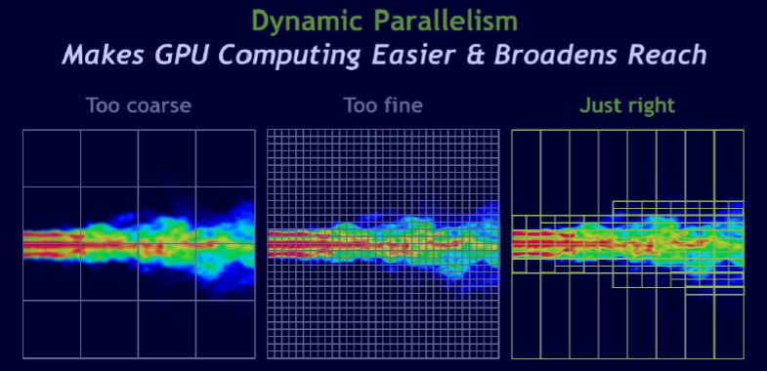
IN DEPTH
Dynamic Parallelism
Allows the GPU to generate new work for itself, synchronize on results, and control the scheduling of that work via dedicated, accelerated hardware paths, all without involving the CPU.
Kernel can launch another kernel ,can create necessary streams, events and manage the dependencies needed to process additional work without the need for host CPU interaction.
Programs can run directly in GPU.

Slide 10
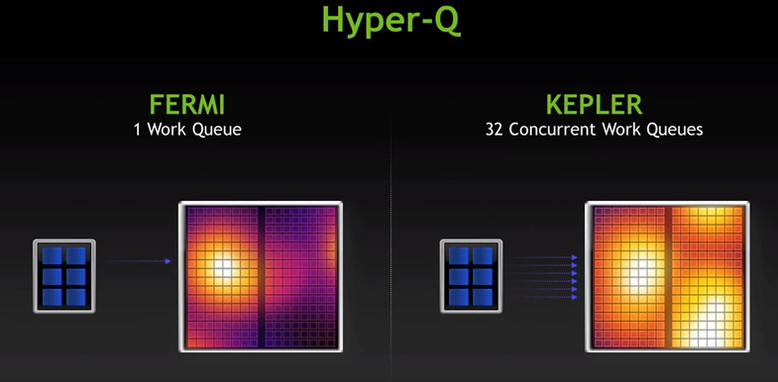
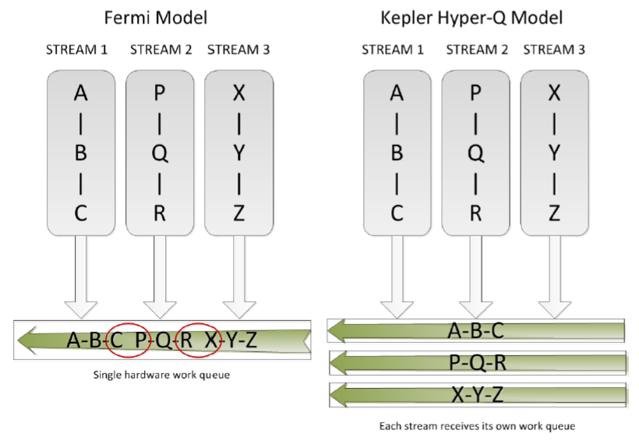
IN DEPTH
Hyper-Q
Increases total number of connections(work queues)between host and CUDA work distributor(CWD) in GPU to 32.
It provides 32x performance increase without changing any existing code.
Each CUDA stream is managed within its own hardware work queue, inter-stream dependencies are optimized, operations in one stream doesn’t block another, enabling streams to execute concurrently.

Slide 11
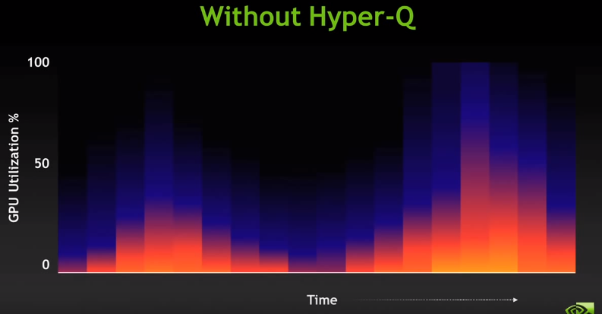
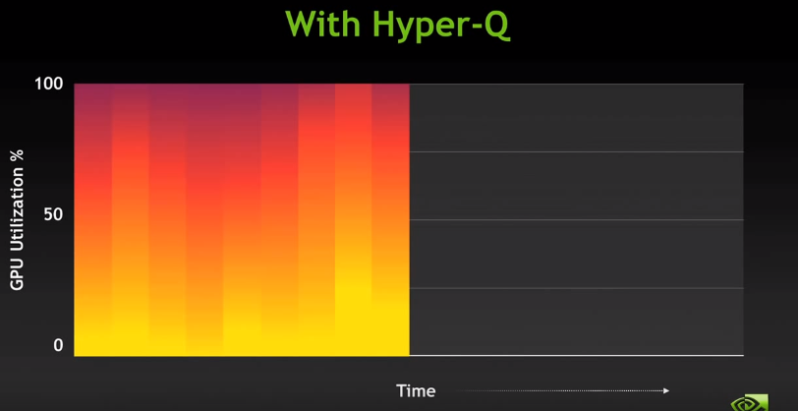
Less utilization of GPU.
Computation takes much time.
Lower Performance.
Comparatively more utilization of GPU by 50%.
Less computational time.
Higher Performance.

Slide 12
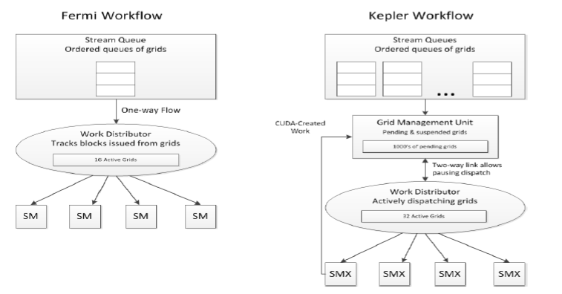
IN DEPTH
Grid Management Unit
Grids can be launched as in Fermi, new grids can also be created programmatically by CUDA within the Kepler SMX unit , managed by Grid management unit(GMU).
CWD(CUDA work Distributor) holds grids to be dispatched, it can dispatch 32 grids. It communicates with GMU via bidirectional link that allows the GMU to pause and dispatch new grids, hold suspended grids until needed.
The GMU also has a direct connection to the SMX units to send the new work back to GMU to be prioritized and dispatched.

Slide 13
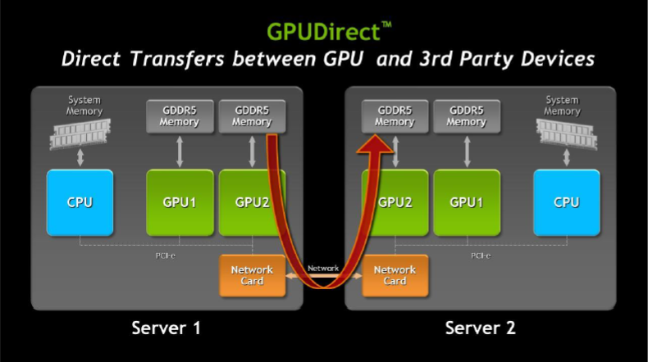
IN DEPTH
NVIDIA GPUDirect™
RDMA(Remote direct memory access) feature, Designed to improve performance by allowing direct access to GPU data for 3rd party devices, such as IB(InfiBand) adapter, NIC’s and SSD.
When using CUDA 5.0 or later, GPUDirect provides the following important features
DMA between NIC and GPU.
Sufficiently improved MPISend/MPIRecv between GPU and other node in network.
Eliminates CPU bandwidth and latency.
Works with variety of 3rd-party network, capture, and storage devices.
Kepler GK110 also supports other GPUDirect features such as Peer-to-Peer and GPUDirect for Video.

Slide 14
THANK YOU

